Slide 1

David M. Kroenke and David J. Auer Database Processing Fundamentals, Design, and Implementation
Chapter Eleven:
The Web Server Environment

Slide 2
Chapter Objectives
To understand the nature and characteristics of the data environment that surrounds Internet technology database applications
To learn the purpose, features, and facilities of ODBC
To understand the characteristics of the Microsoft .NET Framework
To understand the nature and goals of OLE DB
To learn the characteristics and object model of ADO.NET

Slide 3
Chapter Objectives
To understand the characteristics of JDBC and the four types of JDBC drivers
To understand the nature of JSP and know the differences between JSP and ASP.NET
To understand HTML and PHP
To be able to construct Web database applications pages using PHP
Understand the importance of XML
Learn the elements of XML, including XML documents, document type declarations (DTDs), and XML stylesheets

Slide 4
Chapter Objectives
Understand the role of XSLT in materializing XML documents
Learn the basic concepts of XML Schema and understand their importance to database processing
Understand XML documents
Learn the basic concepts of using the SQL SELECT… FOR XML statement

Slide 5
Introduction
Because database applications today reside in a complicated environment, various standards have been developed for accessing database servers.
Some of the important standards:
ODBC (Open Database Connectivity) is the early standard for relational databases.
OLE DB is Microsoft’s older object-oriented interface for relational and other databases.
The .NET Framework and ADO.NET are the current Microsoft “dot NET” data access standards providing easier access to data.
JBDC (Java Database Connectivity) is the Java “equivalent” of ODBC.

Slide 6
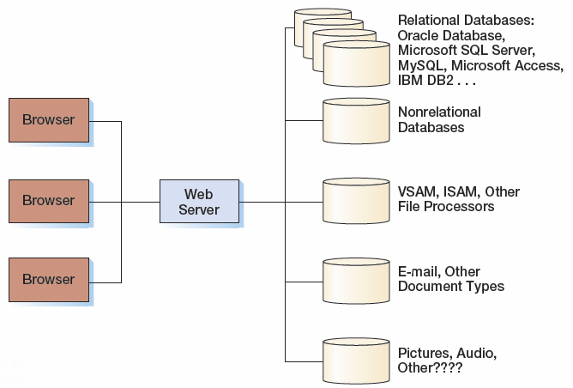
Web Server Data Environment
A Web server needs to publish applications that involve different data types.

Slide 7
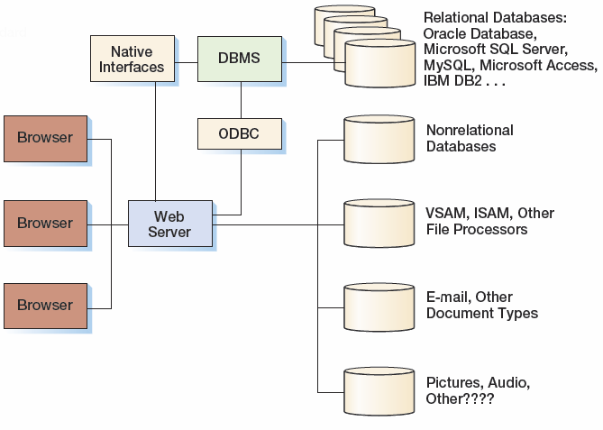
The Role of the ODBC Standard

Slide 8
ODBC
The ODBC (Open Database Connectivity) standard provides a DBMS-independent means for processing relational database data.
It was developed in the early 1990s by an industry committee and has been implemented by Microsoft and many other vendors.
The goal is to allow a developer to create a single application that can access databases supported by different DBMS products without needing to be changed or recompiled.

Slide 9
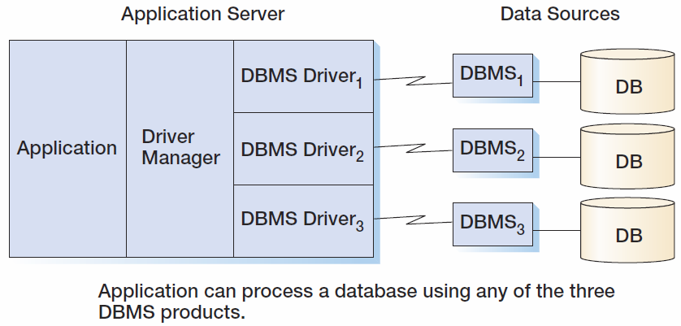
ODBC Architecture

Slide 10
ODBC Components
ODBC consists of a data source, an application program, a driver manager, and a DBMS driver.
A data source is the database, its associated DBMS, operating system, and network platform.
An ODBC data source can be a relational database, a file server, or a spreadsheet.
An applications program issues requests to create a connection with a data source.

Slide 11
ODBC Components
A driver manager determines the type of DBMS for a given ODBC data source and loads that driver in memory.
A DBMS driver processes ODBC requests and submits specific SQL statements to a given type of data source.
A single-tier driver processes both ODBC calls and SQL statements.
A multiple-tier driver processes ODBC calls, but passes the SQL requests to the database server.

Slide 12
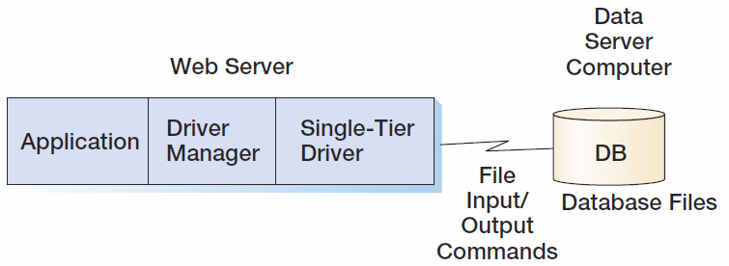
ODBC Driver Types: ODBC Single-Tier Driver

Slide 13
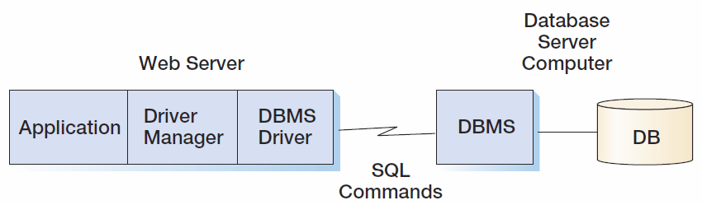
ODBC Driver Types: ODBC Multiple-Tier Driver

Slide 14
Conformance Levels
Levels of conformance balance the scope of the ODBC standard.
There are two types of conformance levels:
ODBC conformance levels concern the features and functions that are made available through the driver’s application program interface (API).
A driver API is a set of functions that the application can call to receive services.
SQL conformance levels specify which SQL statements, expressions, and data types a driver can process.

Slide 15
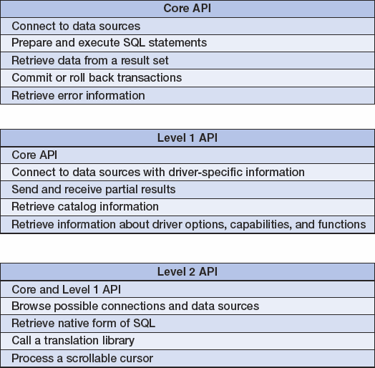
ODBC Conformance Levels

Slide 16
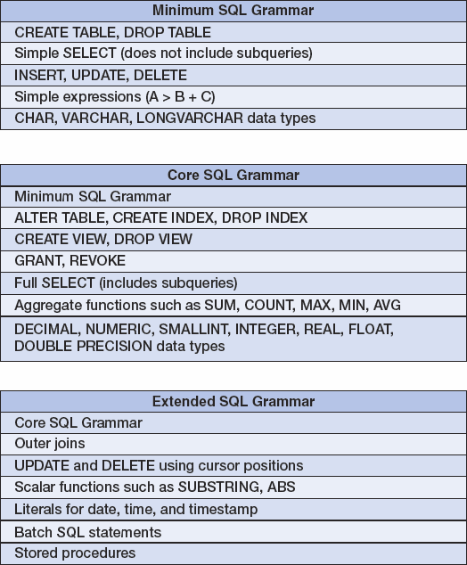
SQL Conformance Levels

Slide 17
ODBC Data Source
A data source is an ODBC data structure that identifies a database and the DBMS that processes it.
Three types of data source names:
A file data source is a file that can be shared among database users having the same DBMS driver and privilege.
A system data source is local to a single computer and may be used by the operating system and any user on that system.
System data sources are recommended for Web servers.
To define a system data source name, the type of driver and the database need to be specified.
A user data source is available only to the user who created it.

Slide 18
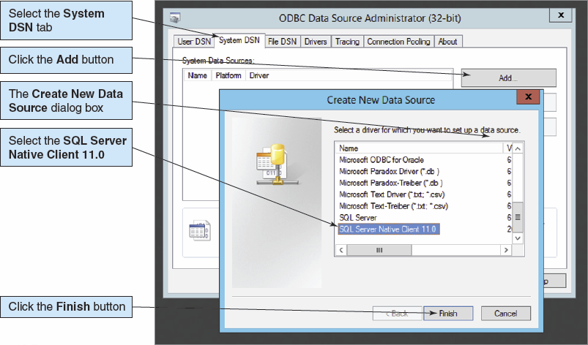
Creating a System Data Source I

Slide 19
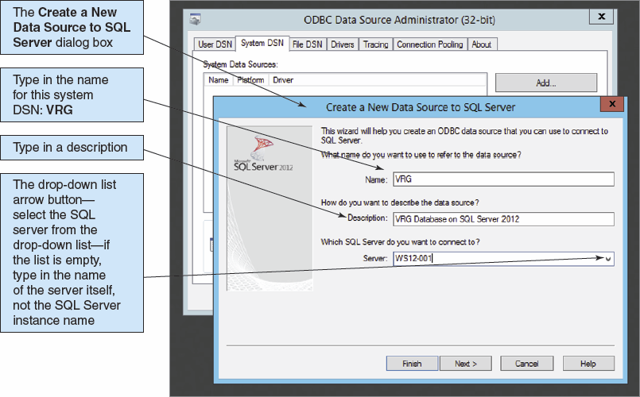
Creating a System Data Source II

Slide 20
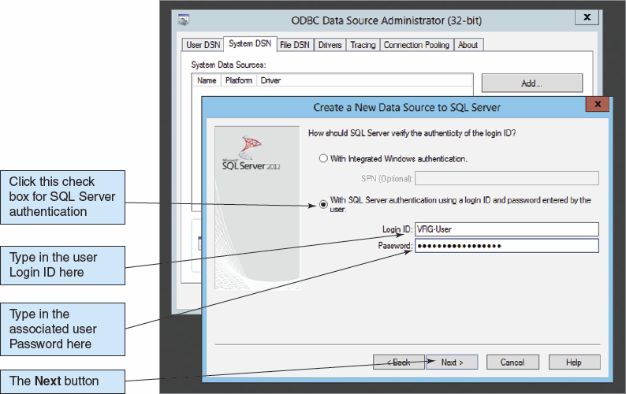
Creating a System Data Source III

Slide 21
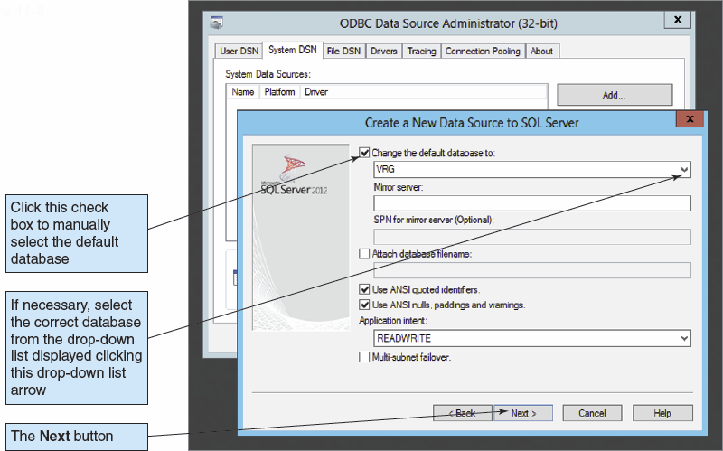
Creating a System Data Source IV

Slide 22
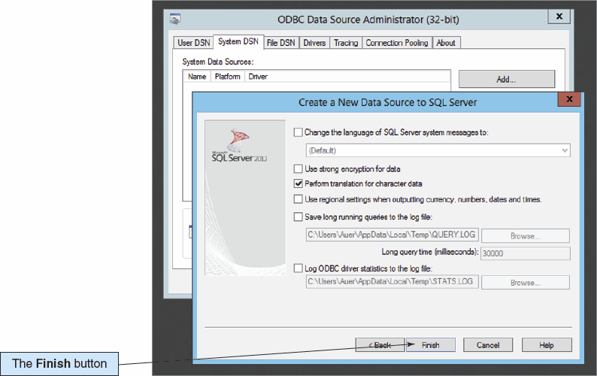
Creating a System Data Source V

Slide 23
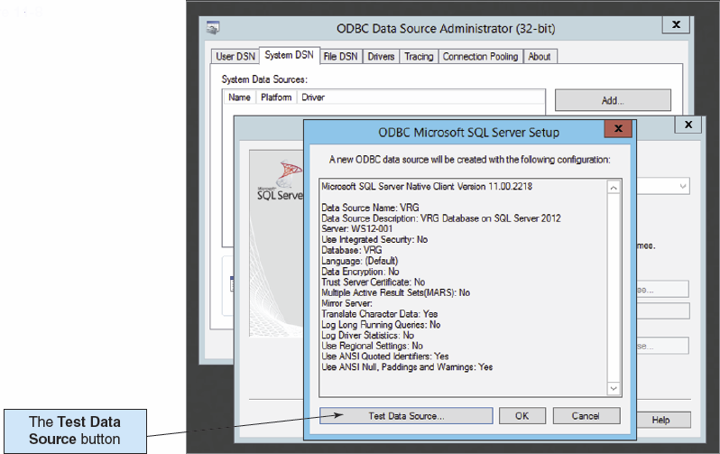
Creating a System Data Source VI

Slide 24
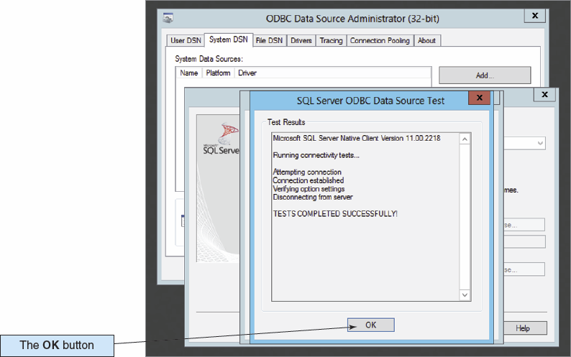
Creating a System Data Source VII

Slide 25
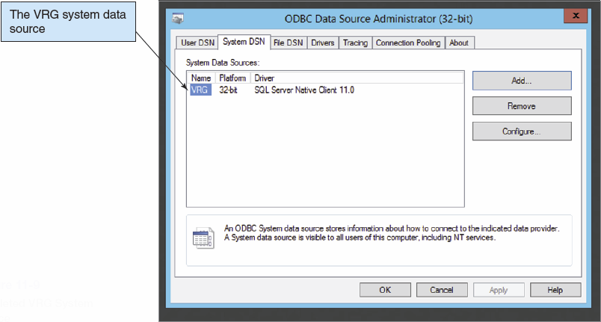
Creating a System Data Source VIII

Slide 26
32-Bit versus 64-Bit ODBC I
The ODBC Data Sources program we have been using is for the 64-bit version of the ODBC data sources administration program, and will create 64-bit ODBC data sources.
These will only work as long as every component in the Web application program chain is a 64-bit program. But, if any component is a 32-bit program, the 64-bit ODBC data source will not work.

Slide 27
32-Bit versus 64-Bit ODBC II
In fact, when you are building the Web database applications in this chapter, if everything seems to be correctly done but the system still does not work, the most likely cause is a 32-bit program in the chain.
To resolve this problem, you will need to use the 32-bit version of the ODBC Data Sources program.
In Window 8 and Windows Server 2012, this is clearly labeled.
In earlier versions of the Windows OS, it is located at C:\Windows\SysWOW64\odbcad32.exe.

Slide 28
32-Bit versus 64-Bit ODBC III
To resolve your Web database application problem, create a 32-bit ODBC data source using ODBC Administrator, and then revise your Web page code to use that ODBC data source.
For more information on the programs in the Windows\SysWOW64 folder, see the Wikipedia article on WoW64 at http:// en.wikipedia.org/wiki/WoW64.

Slide 29
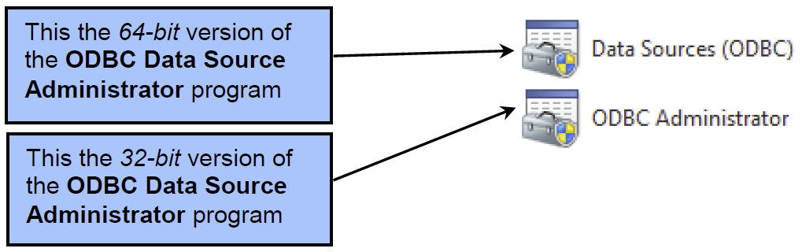
32-Bit versus 64-Bit ODBC IV
In versions of the Windows OS prior to Windows 8 and Windows Server 2012, the two icons for the two versions appear as shown below. Note that although the program icons are the same, the program names are different. Data Source (ODBC ) is the 64-bit version, and ODBC Administrator is the 32-bit version.

Slide 30
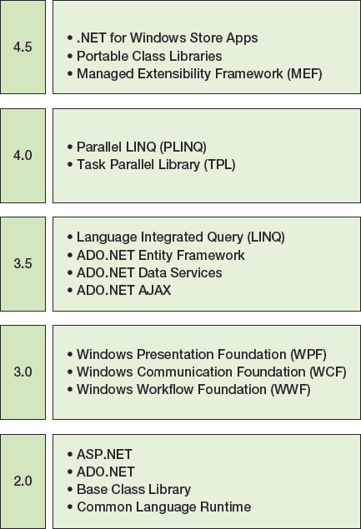
The Microsoft .NET Framework

Slide 31
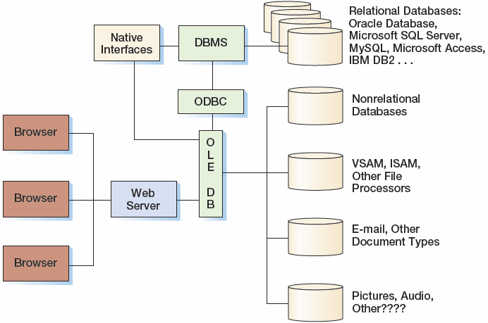
The Role of OLE DB

Slide 32
OLE DB
OLE DB is an implementation of the Microsoft OLE object standard.
OLE DB objects are COM objects and support all required interfaces for such objects.
OLE DB breaks the features and functions of a DBMS into COM objects, making it easier for vendors to implement portions of functionality.
This characteristic overcomes a major disadvantage of ODBC.
With ODBC, a vendor must create an ODBC driver for almost all DBMS features and functions in order to participate in ODBC at all.

Slide 33
Object-Oriented Concepts
An object-oriented programming object is an abstraction that is defined by its properties and methods.
An abstraction is a generalization of something.
A property specifies a set of characteristics of an object.
A method refers to actions that an object can perform.
A collection is an object that contains a group of other objects.

Slide 34
OLE DB Goals
Create object interfaces for DBMS functionality pieces:
Query, update, transaction management, etc.
Increase flexibility:
Allow data consumers to use only the objects they need
Allow data providers to expose pieces of DBMS functionality
Providers can deliver functionality in multiple interfaces
Interfaces are standardized and extensible
Provide object interfaces over any type of data:
Relational and non-relational database, ODBC or native, VSAM and other files, Email, and others.
Do not force data to be converted or moved from where it is

Slide 35
OLE DB Basic Constructs
There are data consumers and data providers:
Data consumers—users of OLE DB functionality
Data providers—sources of OLE DB functionality
An interface is a set of objects and the properties and methods they expose in that interface:
Objects may expose different properties and methods in different interfaces.
An implementation is how an object accomplishes its tasks:
Implementations are hidden from the outside world and may be changed without impacting the users of the objects.

Slide 36
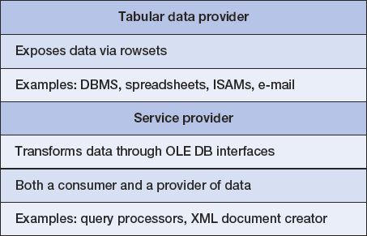
OLE DB Data Providers
A rowset is equivalent to a cursor.
OLE DB has two types of data providers:

Slide 37
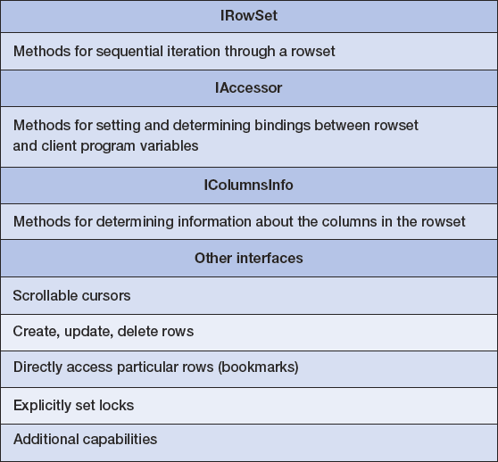
Rowset Interfaces

Slide 38
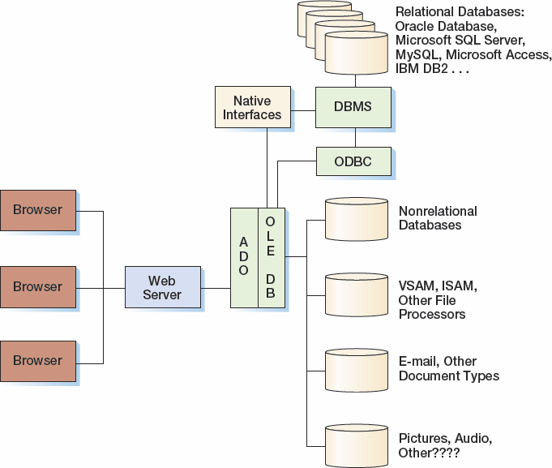
The Role of ADO

Slide 39
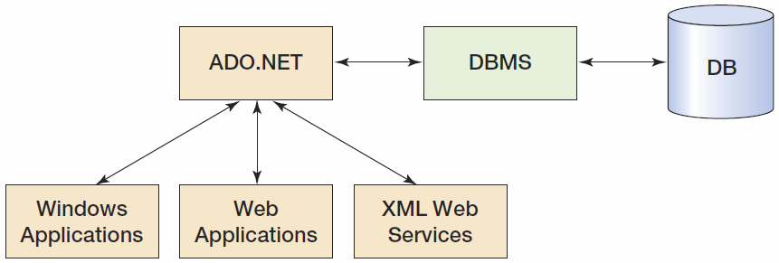
The Role of ADO.NET

Slide 40
Data Provider
A .NET data provider is a library of classes that provides ADO.NET services.
Microsoft provides three data providers:
OLE DB data provider can be used to process any OLE DB-compliant data source.
SQL Server Client data provider is purpose-built for use with SQL Server.
Oracle Database Client data provider is purpose-built for use with Oracle Database.

Slide 41
Data Provider Components
A connection object is similar to the ODBC’s connection object.
A command object is created on an established connection.
A data reader provides read-only, forward-only, fast access to database data.
An application can get and put data to and from the database using the command object.
A DataSet is an in-memory database that is disconnected from any regular database.
It distinguishes ADO.NET from the previous data access technology.

Slide 42
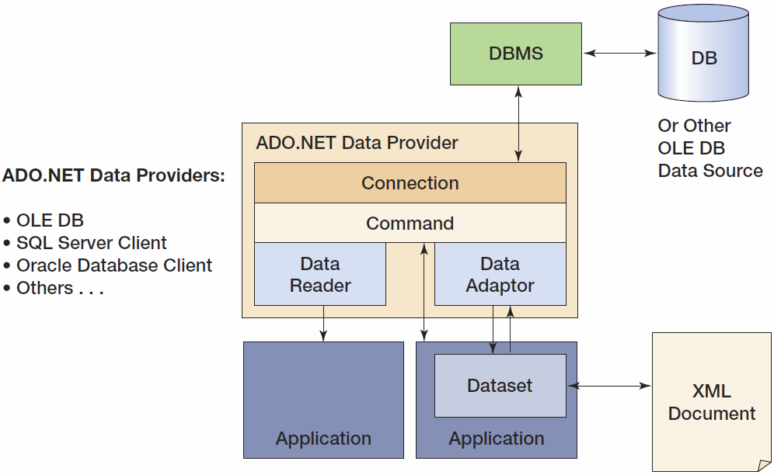
Data Provider Components

Slide 43
The ADO.NET DataSet
A DataSet is an in-memory database that is disconnected from any regular database.
DataSets can have:
Multiple tables, views, and relationships.
Tables may have surrogate key (auto increment columns), primary keys, and be declared as unique.
Referential integrity rules and actions.
The equivalent of triggers.
DataSets may be constructed from several different databases and managed by different DBMS.

Slide 44
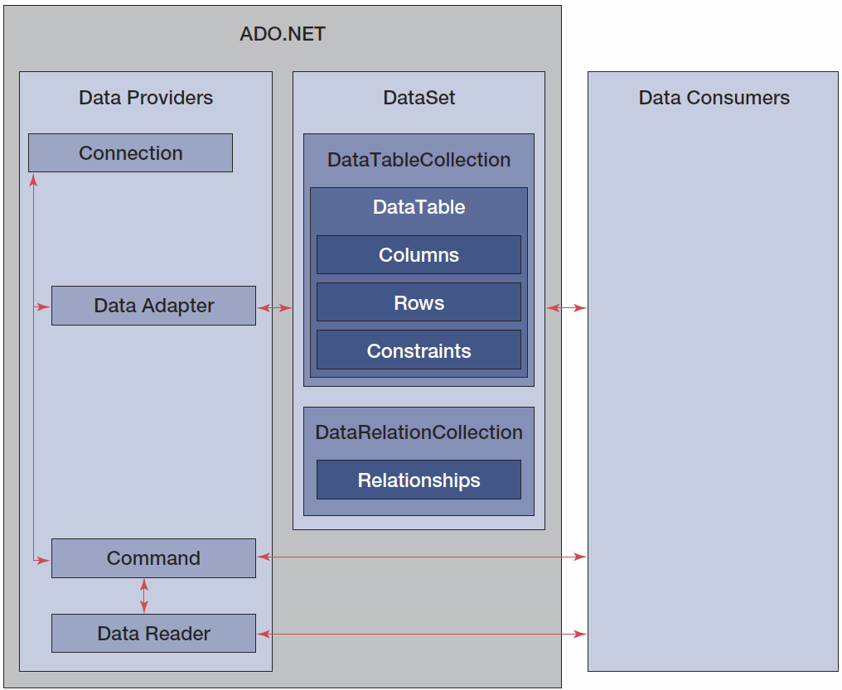
The ADO.NET Object Model

Slide 45
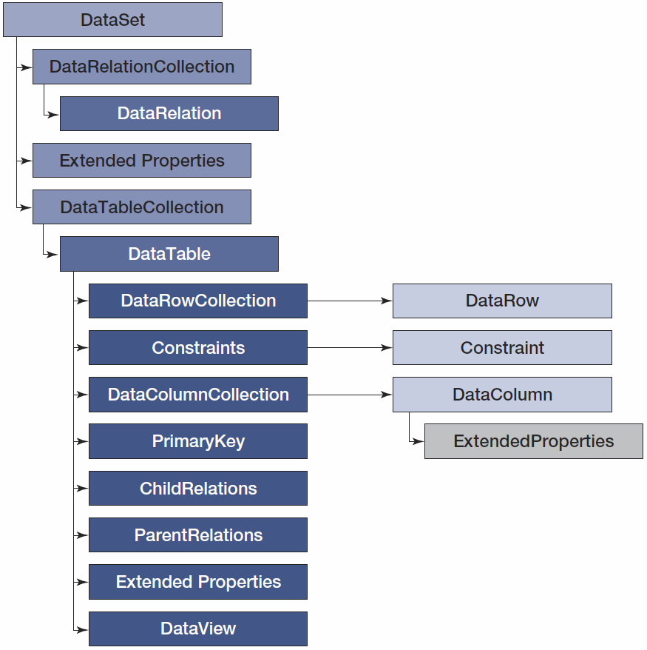
The ADO.NET Dataset Object Model

Slide 46
DataSet Advantages
DataSet contents and its XML schema can be easily formatted as an XML document.
Also, XML schema documents can be read to create the structure of the dataset, and XML documents can be read to fill the dataset.
DataSets are needed to provide a standardized, nonproprietary means to process database views.
This is important for the processing of views with multiple multivalue paths.

Slide 47
DataSet Disadvantages
Because DataSet data is disconnected from the regular database, only optimistic locking can be used when updating the regular database with the DataSet.
In the case of conflict, either the dataset must be reprocessed or the data change must be forced onto the database, causing the lost update problem.
Thus, datasets cannot be used for applications in which optimistic locking is problematical.
Instead, the ADO.NET command object should be used.

Slide 48
JDBC
JDBC is an alternative to ODBC and ADO that provides database access to programs written in Java.
JDBC used to be a “nonacronym”—it didn’t stand for anything!
Now it stands for Java DataBase Connectivity.
JDBC drivers are available for most DBMS products:
http://java.sun.com/products/jdbc

Slide 49
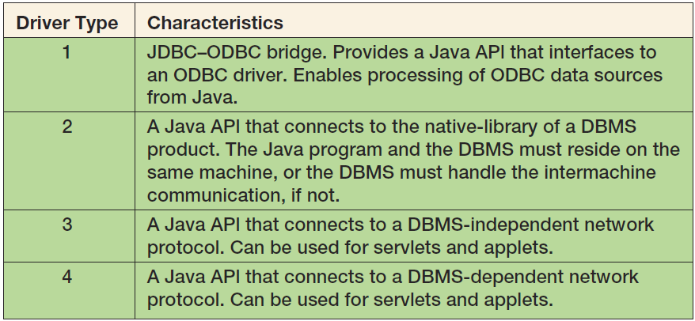
JDBC Driver Types

Slide 50
Java Servlets and Applets
Java programs are compiled into an operating system independent bytecode.
Various operating systems use their own bytecode interpreters a.k.a. Java virtual machines.
An applet is transmitted to a browser via HTTP and is invoked on the client workstation using the HTTP protocol.
A servlet is a Java program that is invoked on the server to respond to HTTP requests.
Type 3 and Type 4 drivers can be used for both applets and servlets.
Type 2 drivers can be used only in servlets.

Slide 51
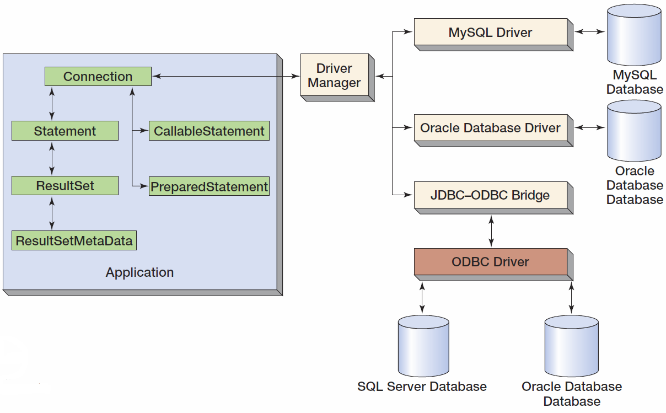
JDBC Components

Slide 52
Java Server Pages
Java Server Pages (JSP) provide a means to create dynamic Webpages using HTML, XML, and Java.
JSPs provide the capabilities of a full object-oriented language to the page developer.
Neither VBScript nor JavaScript can be used in a JSP.
JSPs are compiled into machine-independent bytecode.

Slide 53
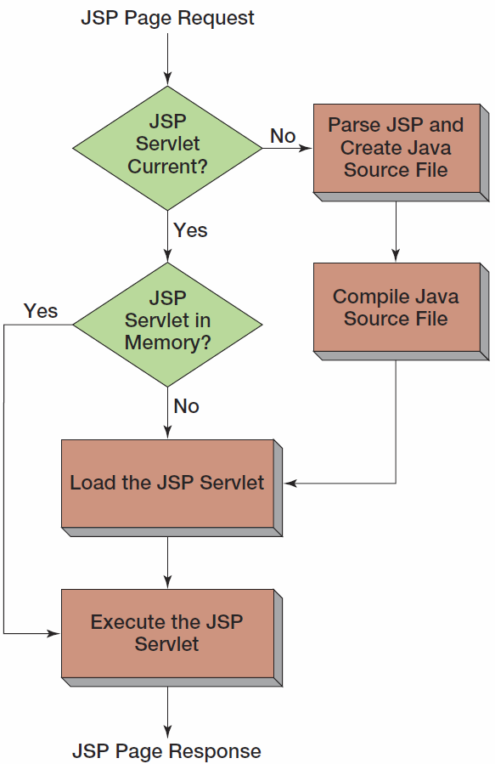
JSP Compilation Process

Slide 54
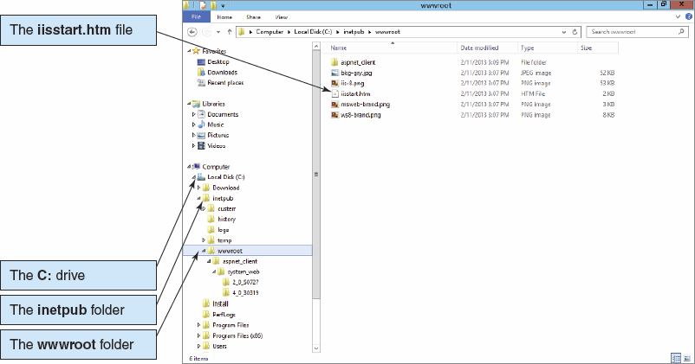
IIS Web Server I

Slide 55
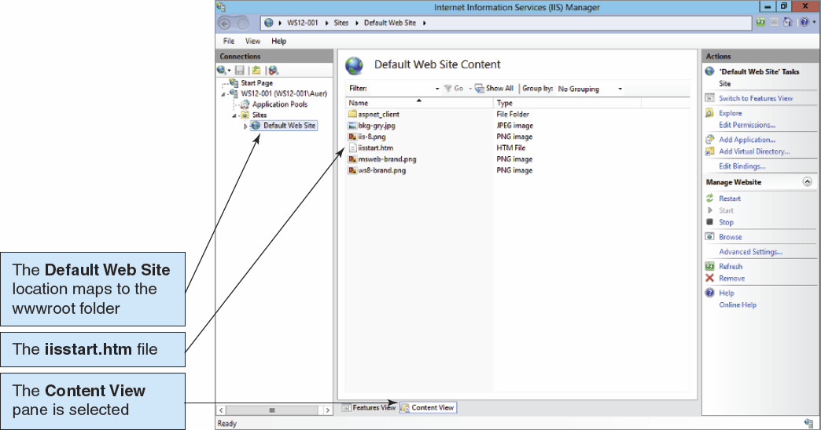
IIS Web Server II

Slide 56
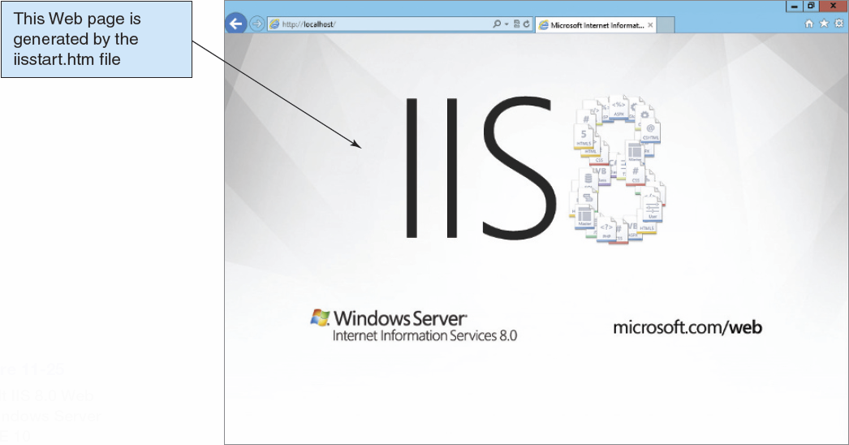
IIS Web Server III

Slide 57
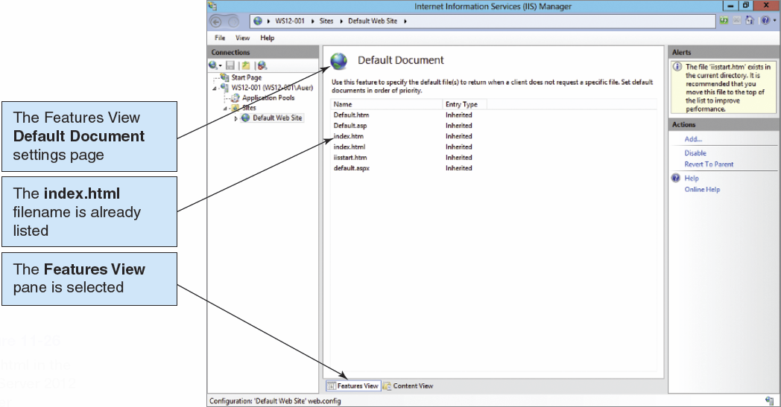
index.html as Default Document

Slide 58
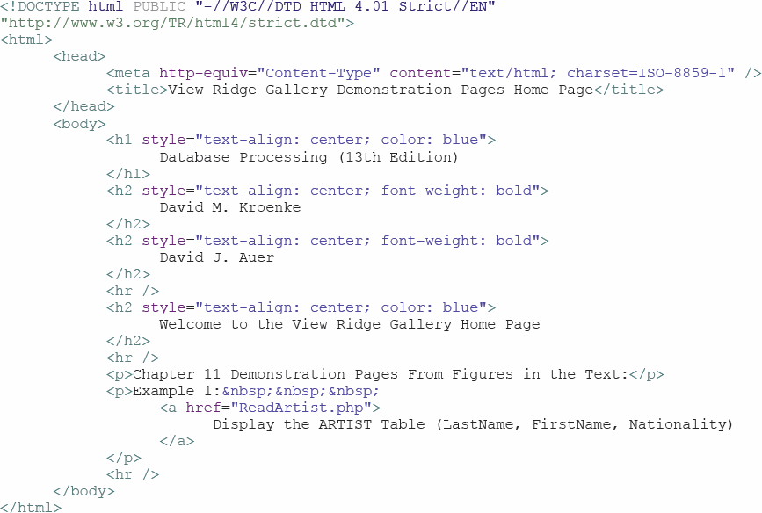
index.html

Slide 59
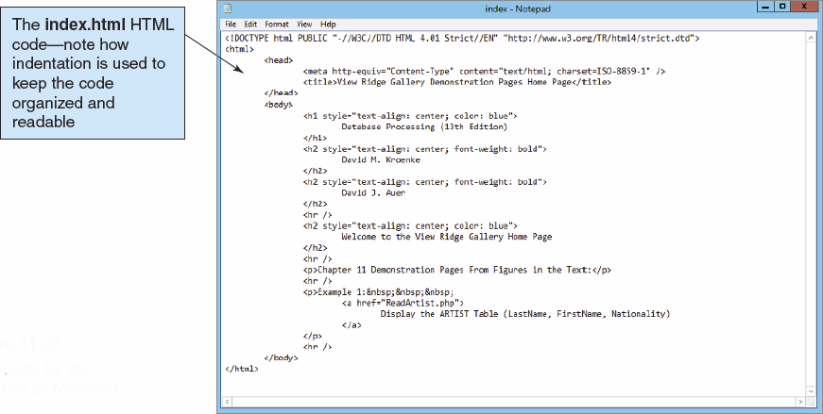
index.html in Microsoft Notepad

Slide 60
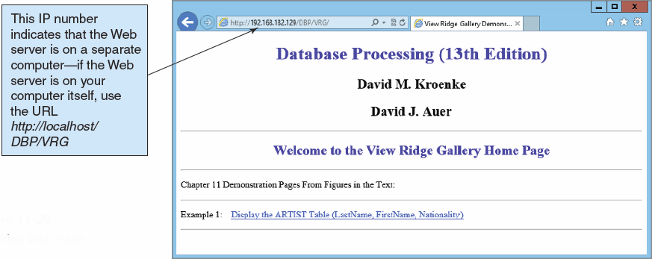
index.html in a Web Browser

Slide 61
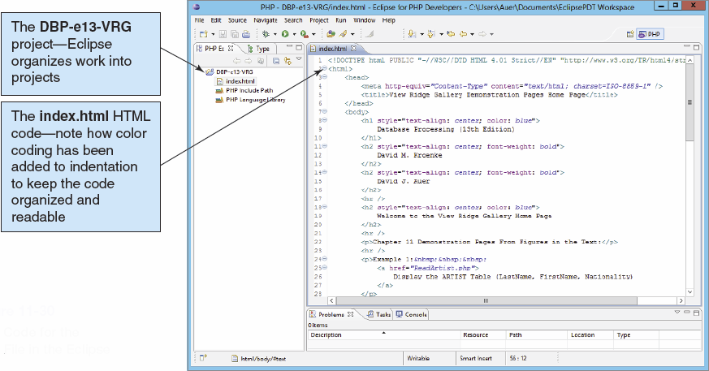
index.html in Eclipse

Slide 62
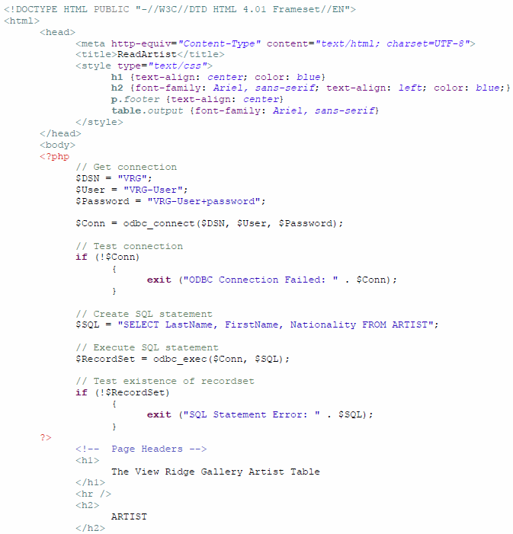
ReadArtist.php I

Slide 63
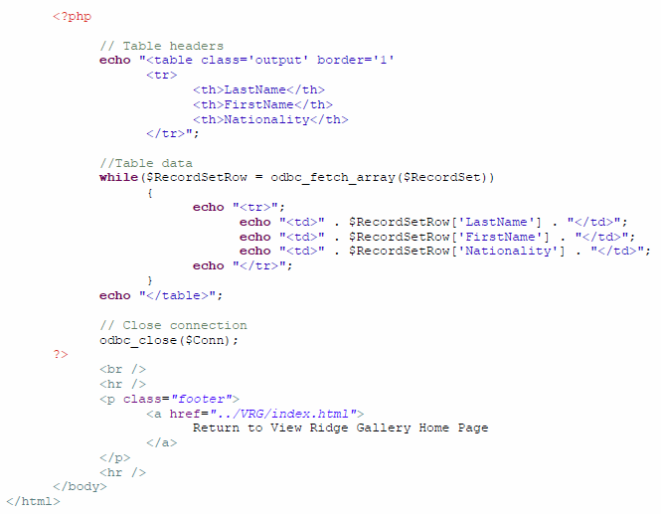
ReadArtist.php II

Slide 64
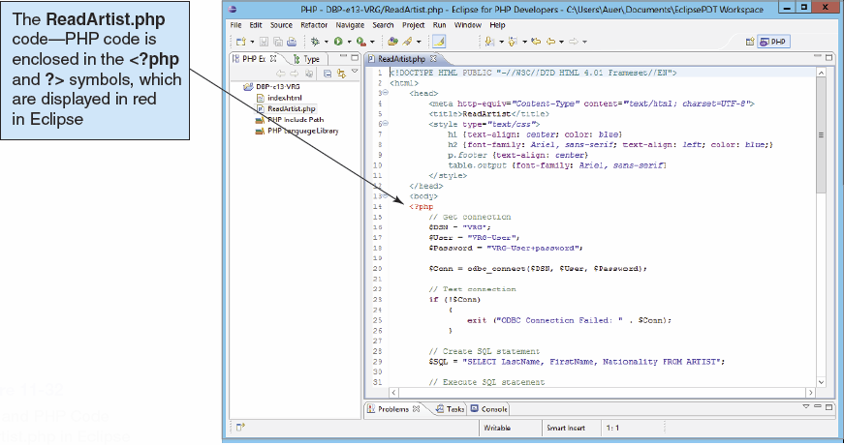
ReadArtist.php in Eclipse

Slide 65
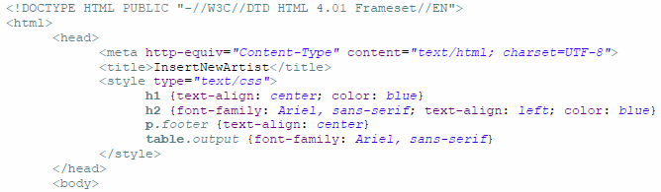
ReadArtist.php Initial HTML Code

Slide 66
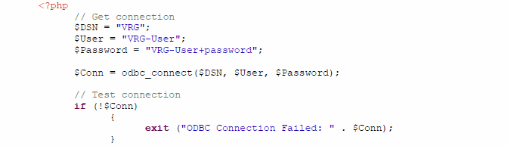
ReadArtist.php Creating a Connection

Slide 67
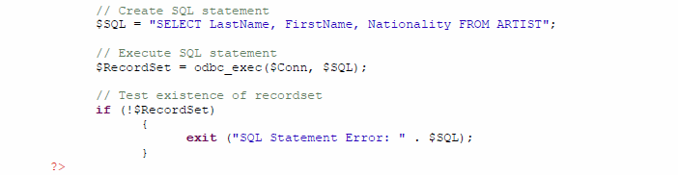
ReadArtist.php Creating a RecordSet

Slide 68

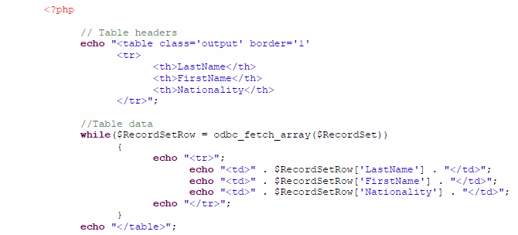
ReadArtist.php Displaying the Results

Slide 69
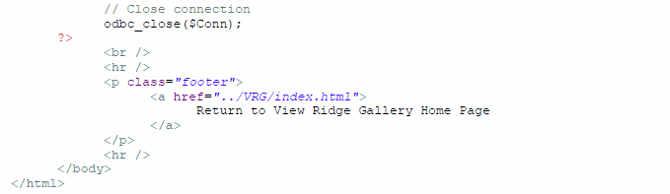
ReadArtist.php Disconnecting from the Database

Slide 70
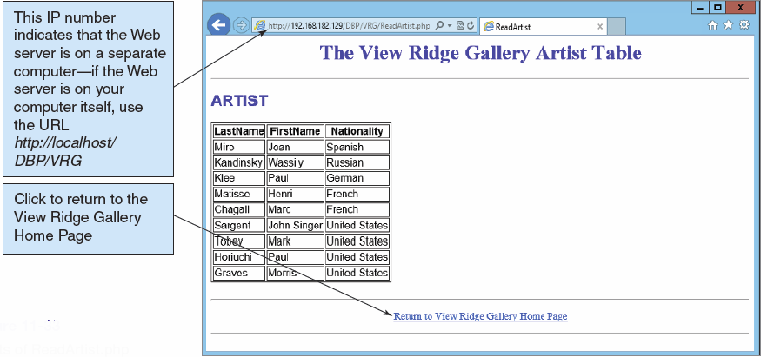
ReadArtist.php in the Web Browser

Slide 71
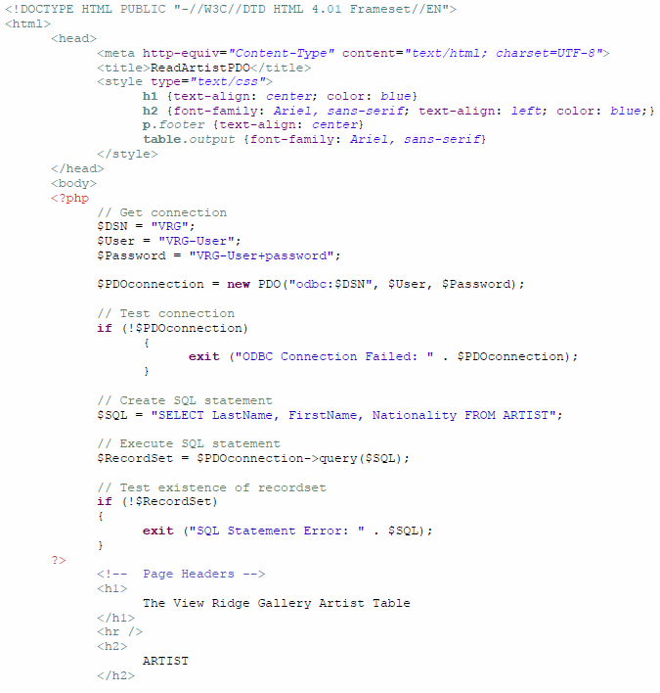
ReadArtistPDO.php I

Slide 72
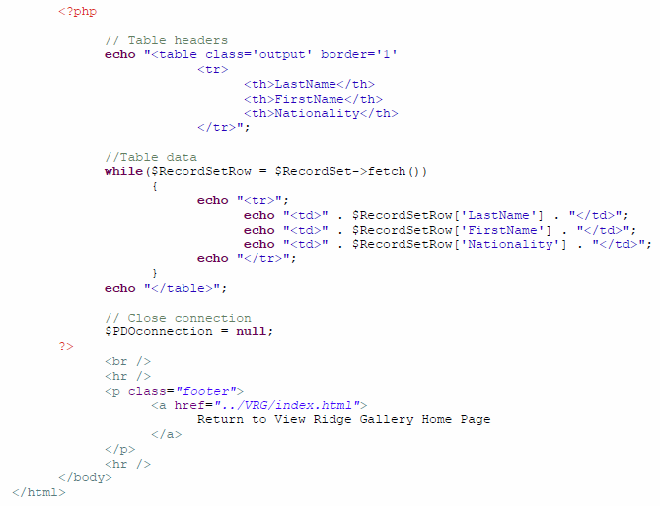
ReadArtistPDO.php II

Slide 73
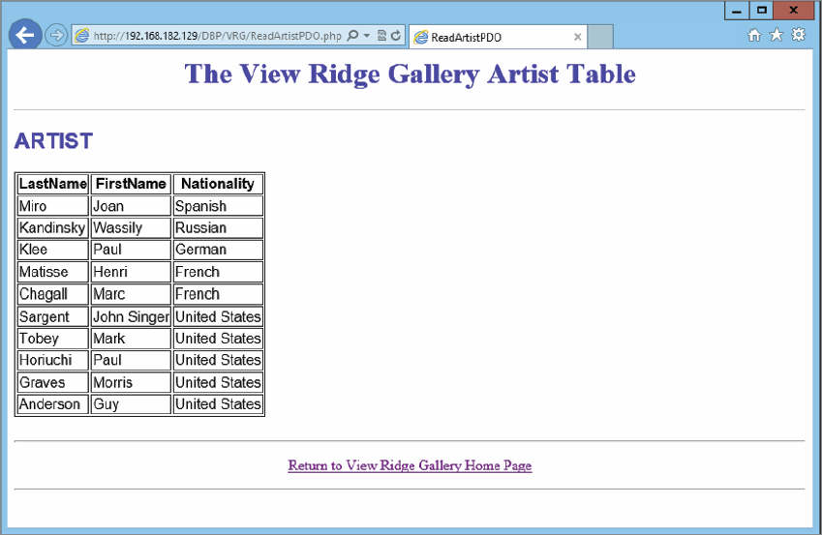
ReadArtistPDO.php in the Web Browser

Slide 74
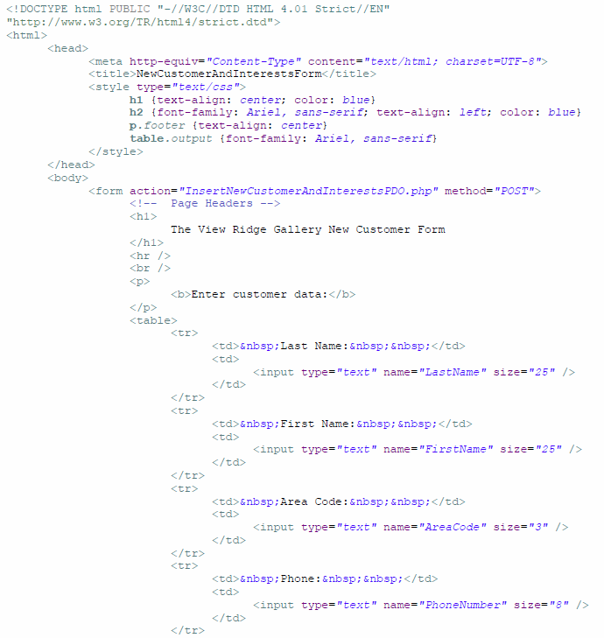
NewCustomerAndInterestsForm.html I

Slide 75
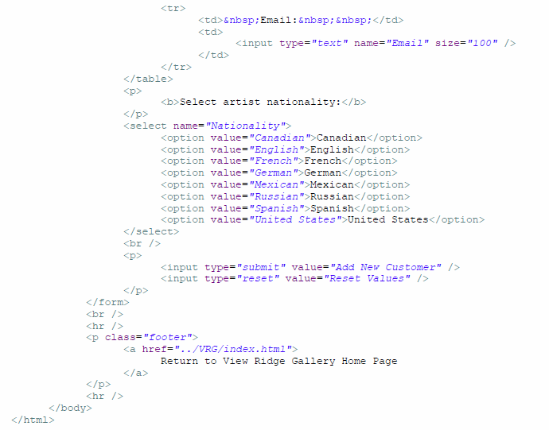
NewCustomerAndInterestsForm.html II

Slide 76

The New Customer and Interests Form

Slide 77

InsertCustomerAndInterestsPDO.php l

Slide 78

InsertCustomerAndInterestsPDO.php lI

Slide 79

InsertCustomerAndInterestsPDO.php lII

Slide 80

The New Customer Acknowledgement Page

Slide 81
Introduction to XML
Database processing and document processing need each other.
Database processing needs document processing for expressing database views.
Document processing needs database processing for storing and manipulating data.
As Internet usage increases, organizations want to make their Webpages more functional by displaying and updating data from organizational databases.

Slide 82
XML
XML, or Extensible Markup Language, was developed in the early 1990s:
XML is a subset of SGML, or Standard Generalized Markup Language.
Today XML is a hybrid of document processing and database processing.
It provides a standardized yet customizable way to describe the content of documents.
XML documents can automatically be generated from database data and vice versa.
SOAP is an XML-based standard protocol for sending messages of any type, using any protocol over the Internet.

Slide 83
XML
XML is used for describing, representing, and materializing database views.
XML is better than HTML because:
It provides a clear separation between document structure, content, and materialization.
It is standardized but allows for extension by developers.
XML tags accurately represent the semantics of their data.
Document Type Declarations (DTDs) and XML Schemas can be used to describe the content of XML documents.
SQL Server, Oracle Database, and MySQL can produce XML documents from database data.

Slide 84
XML DTD
XML document consists of two sections:
Document Type Declaration (DTD)
The DTD begins with DOCTYPE <document_type_name>
Document data
An XML document can be:
Type-valid if the document conforms to its DTD
Well-formed and not be type-valid, if
It violates the structure of its DTD, or
It has no DTD.
A DTD may be stored externally so many documents can be validated against the same DTD.

Slide 85
XMLSpy
The diagrams in the text and in the following slides were prepared with Altova’s XMLSpy.
There is a downloadable trial version available.

Slide 86

XML Document with Internal DTD

Slide 87

XML Document with External DTD

Slide 88
XSLT
XSLT, or the Extensible Style Language may be used to materialize (transform) XML documents.
From XML documents into HTML or into XML in another format
XSLT is a declarative transformation language:
Declarative: create rules, not procedure, to materialize the document
Transformational: transforms the input document into another document
XSLT uses stylesheets to indicate how to transform the elements of the XML documents into another format.

Slide 89

External DTD for CustomerList

Slide 90

XML Document with Two Customers

Slide 91

Example XSL Stylesheet

Slide 92

Result in Web Browser

Slide 93
XML Schema
XML Schema is a standard for describing the content of an XML document, i.e., defining custom vocabularies.
Documents that conform to an XML Schema are called schema-valid.
An XML document can be well-formed and be neither type-valid nor schema-valid.
Unlike DTDs, XML Schema documents are themselves XML documents that can be validated against the schema maintained by W3C.

Slide 94

XML Schema Document

Slide 95

XML Schema

Slide 96

Schema-Valid XML Document

Slide 97
Elements and Attributes
Schemas consist of elements and attributes.
Elements are used to carry data and attributes are used to carry metadata.
Two types of elements:
Simple elements have a single data value.
ComplexType elements can have one or more simple or complexType elements.
ComplexType elements can have attributes.

Slide 98

Flat Schemas: XML Schema
Flat schemas have all elements at the same level:

Slide 99

Flat Schemas: Graphical Representation of Schema

Slide 100

Flat Schemas: Schema-Valid Document

Slide 101

Structured Schemas: XML Schema
Structured schemas have defined subgroups.

Slide 102

Structured Schemas: Graphical Representation of Schema

Slide 103

Structured Schemas: Schema-Valid Document

Slide 104
Global Elements
To eliminate the definition duplication, elements can be declared globally, i.e., reside at the top level of the schema, and then reused.

Slide 105

Global Elements: XML Schema with Global PhoneType

Slide 106

Global Elements: PhoneType Global Element

Slide 107

Global Elements: Graphical Representation of Schema

Slide 108
Creating XML Documents from Database Data
SQL Server, Oracle Database, and MySQL can generate XML documents from database data.
For SQL Server:
SELECT…FOR XML
SELECT…FOR XML RAW—places the values of columns as attributes in the XML document
SELECT…FOR XML AUTO, ELEMENTS—places the values of columns as elements in the XML document
SELECT…FOR XML EXPLICIT—allows the designation of which values of columns become attributes and elements
XMLSpy can generate schemas from such output.

Slide 109

SQL FOR XML RAW I

Slide 110

SQL FOR XML RAW II

Slide 111

SQL FOR XML RAW III

Slide 112

SQL FOR XML AUTO, ELEMENTS I

Slide 113

SQL FOR XML AUTO, ELEMENTS II

Slide 114

SQL FOR XML AUTO, ELEMENTS III Partial Output

Slide 115
XML Schema with Multivalue Paths
Some views cannot be created in a single SQL statement because the construct requires two or more multivalued paths.
XML does not have this limitation.
An XML document can have as many multivalued paths as necessary.

Slide 116


Multivalue Paths: XML Schema with Two Multivalued Paths

Slide 117

Multivalue Paths: Graphical View of the Schema

Slide 118

Industries with XML Industry Standards I

Slide 119

Industries with XML Industry Standards II

Slide 120

XML Standards I

Slide 121
XML Standards II
XML: Extensible Markup Language
XSL: XSLT Stylesheet, the document that provides the {match, action} pairs and other data for XSLT to use when transforming an XML document
XSLT: a program that applies XSLT Stylesheets to an XML document to produce a transformed XML document
XML Schema: an XML-compliant language for constraining the structure of an XML document

Slide 122
XML Standards III
XPath
A sublanguage within XSLT used to identify parts of an XML document to be transformed
Can also be used for calculations and string manipulation
XPointer
A standard for linking one document to another
SAX: Simple API (application program interface) for XML
An event-based parser that notifies a program when the elements of an XML document have been encountered during document parsing

Slide 123
XML Standards IV
DOM: Document Object Model
An API that represents an XML document as a tree
Each node of the tree represents a piece of the XML document.
A program can directly access and manipulate a node of the DOM representation.
XQuery
A standard for expressing database queries as XML documents
The structure of the query uses XPath facilities, and the result of the query is represented in an XML format.
XML Namespaces
A standard for allocating terminology to defined collections
X:Name is interpreted as the element Name as defined in namespace X.
Useful for disambiguating terms

Slide 124
David Kroenke and David Auer Database Processing Fundamentals, Design, and Implementation (13th Edition)
End of Presentation:
Chapter Eleven

Slide 125

All rights reserved. No part of this publication may be reproduced, stored in a retrieval system, or transmitted, in any form or by any means, electronic, mechanical, photocopying, recording, or otherwise, without the prior written permission of the publisher. Printed in the United States of America.

